Slide 1
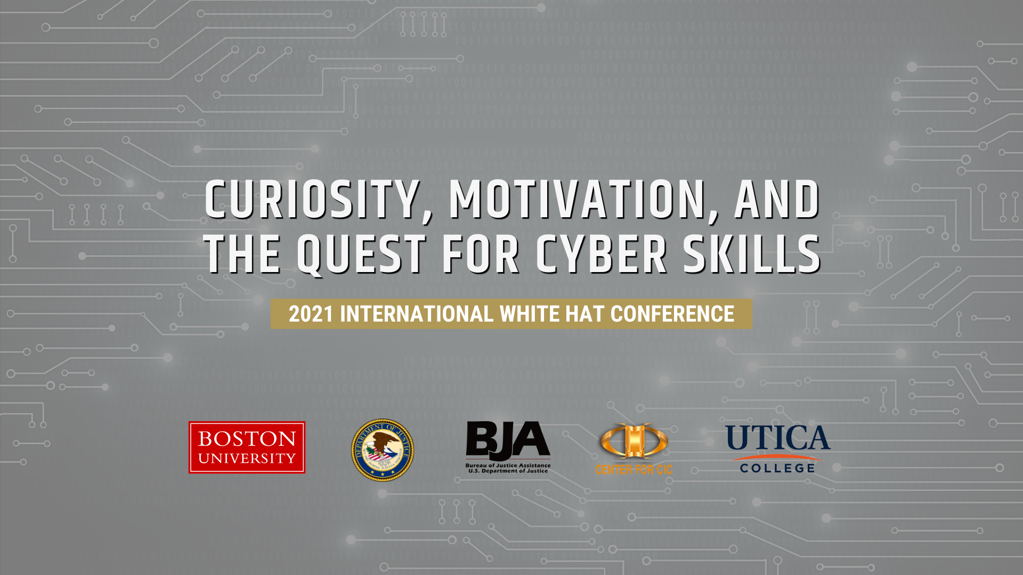
Notes:
With the goal of this year’s white hat conference being to “identify innovative solutions against cybercrime”, I found it valuable to open the conference by discussing a means for overcoming technical skill gaps.
For those in the audience who consider themselves budding cybersecurity professionals, one of the following descriptions may resonate with you, depending on your background:
As an academic student, you’ve yet to gain much practical cybersecurity experience, and at times you find it difficult to identify means for applying your theoretical knowledge to cybersecurity operations.
As a law enforcement professional, you’ve spent much of your career filling traditional roles and have since acquired a limited set of technical cybersecurity skills to fight cyber crime. You’ve gained an awareness of cybersecurity methodology through instructor-led training, but seek more opportunities to build technical skills faster.
Maybe neither of those apply to you. Maybe you are already a cybersecurity rockstar. If that’s the case, I hope you enjoy my talk anyway >_<. My goal today, besides introducing you to the White Hat conference, is to inform and inspire you as you trek on your cybersecurity journey. I hope you find this presentation relatable, approachable, and inviting.

Slide 2
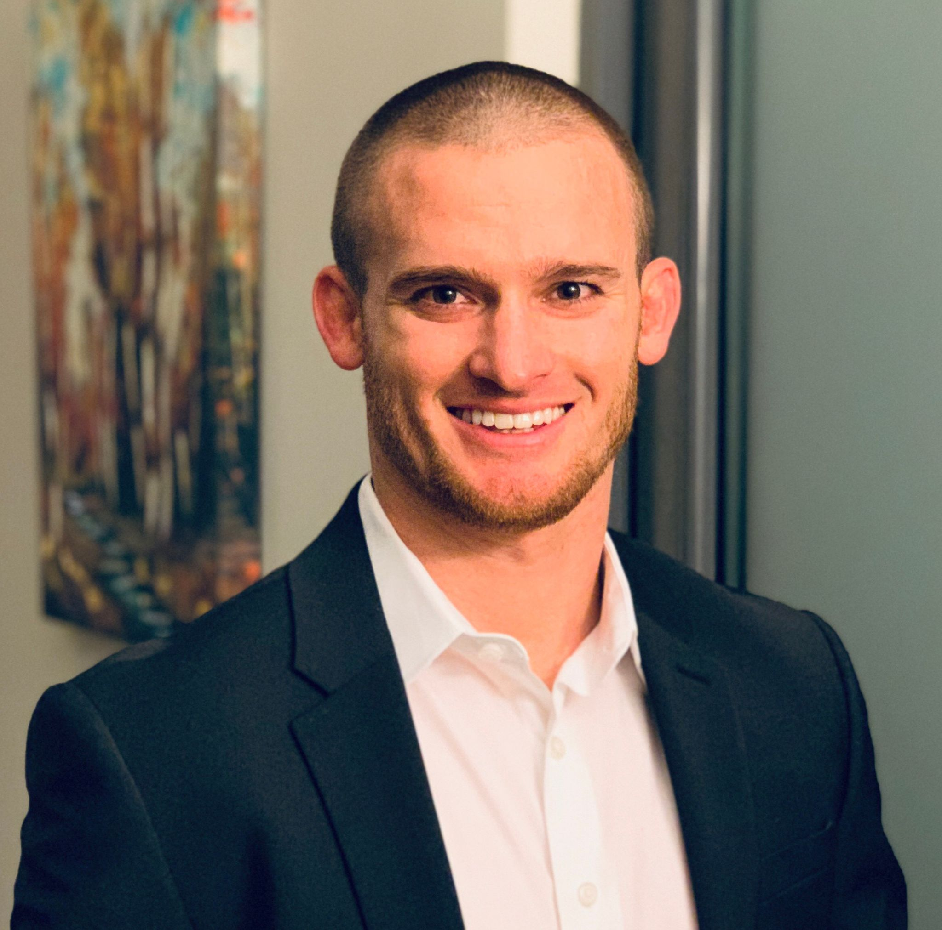
Sean Donnelly
Current Roles
Founder & CEO – Resolvn, Inc.
Principal Engineer – Joint Cyber Training Enterprise
Past Roles
Deputy Branch Chief – National Security Agency
Technical Director – U.S. Navy Blue Team
Education
United States Naval Academy `13
Boston University `18
Certifications
OSCP
GPEN
CISSP
Awards
2017 SANS Core NetWars Champion
2018 AFCEA Military Leadership Recipient
2020 Finalist – CAMI Company to Watch
2021 Forbes 30 under 30 Honoree
Qualifications
U.S. Navy Cryptologic Warfare Officer (CWO)
U.S. Navy Information Warfare Officer (IWO)
Notes:
Before I talk to you about building cyber skills, let me tell you a bit about myself.
My name is Sean Donnelly. Over the past ten years I’ve built technical skills applicable to both offensive and defensive cybersecurity work roles. I’ve done so through academia, and on-the-job training, but mainly through my own structured and unstructured study. Along the way I attended the United States Naval Academy and Boston University, served in the U.S. Navy, and founded a company focused on helping others build advanced technical skillsets in both the government and commercial sectors.

Slide 3
Overview
Digital Forensics Skill Mapping
Skill-building Traits
Learning Material Landscape
A Practical Self-study Framework
Resources
Notes:
Here are the topics I’ll dive into:
I’ll highlight digital forensics disciplines and ask you to reflect on your current skill level
I’ll discuss character traits I feel are critical for building new technical skills
I’ll give an overview of the numerous knowledge sources you can tap into for learning technical information security concepts
I’ll present a framework you can use can use to facilitate skill building
And finally, I’ll point you toward some additional resources
Ultimately, I hope you walk away understanding that instructor-led and on-the-job training aren’t enough to build expertise at the rate you might want to...but that with a willingness to practice being curious, a bit of self-motivation, and a plan – you can level up!

Slide 4
Digital Forensics Skill Mapping
Notes:
Before I get into approaches for honing soft skills and a methodology for building hard skills, let’s first unpack digital forensics. Of all the information security disciplines, I think it’s fair to say “digital forensics” is most interesting to this audience..so I will focus on it moving forward.
The radar chart you see here is an example..meant to graphically depict the skill level of a digital forensics practitioner across 5 subdisciplines. Each of the 10 dashed lines represent a skill level.. and the outside-most dashed line, line 10, represents skill mastery. [Pause 5 seconds]. Now that you’ve given the diagram a once over, ask yourself “What does my digital forensics skills radar chart look like?” Try to imagine it.
When we think of the quintessential law enforcement digital forensicator, skills related to mobile forensics and disk forensics may come to mind... but “digital forensics” also encompasses the live forensics and network forensics subdisciplines, and many criminal cases today rely on related skill sets. Those latter subdisciplines may be foreign to you, and that’s alright. I’ll do my best to briefly explain their importance.
The collection and preservation of forensically sound evidence has long been tightly coupled with “dead-box forensics” – for those who have not heard that term before, dead-box forensics involves obtaining a bit-for-bit duplicate image of storage from a powered-down system, then analyzing the image offline.
In recent years, criminals have shifted their tactics, techniques, and procedures to significantly decrease interaction with non-volatile storage. Instead, they’ve pivoted to new methodology that is heavily reliant on modifying running system memory. Live forensics and network forensics both facilitate the use of techniques to detect memory-resident malicious activity.
Furthermore, these techniques can often be executed remotely, allowing for practitioners to, in some cases, act quicker and reach systems that they can’t access physically.

Slide 5
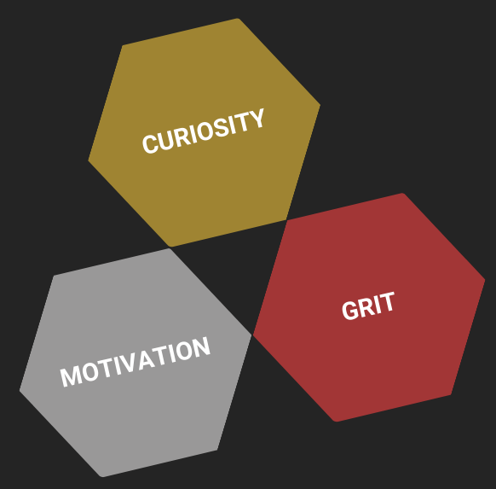
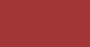
Skill-building Traits
?
Notes:
People work in cybersecurity for one or more different reasons –
Some do it for the joy of solving hard problems
Others are passionate about making the world safer by taking down criminals
A lot of people do it because the field pays well
Or because the day-to-day technical work is particularly compelling
And many do it simply to provide for family
All of those are great reasons to work in cybersecurity, and no matter your reasons, you probably want to be really good at it.
Throughout the hundreds of technical cybersecurity professionals I’ve met and led throughout my career, all of the really good ones share two character traits – Curiosity and Motivation. These rockstars are what I’d consider “Autodidacts” –self-taught people who continuously lean on curiosity and motivation to propel them.
At this point you may be thinking – “I’m curious and motivated”.. or maybe..“I used to be curious and motivated”. And some tuned in are telling themselves “I can’t remember the last time I was curious about or motivated by my work”.
A smaller number of truly exceptional people I’ve met over the years have a third character trait – Grit. Grit can also be described as “resolve” or “fortitude”. That is, an uncanny ability to persevere through difficult times. In my opinion, grit is the one trait that gets significantly stronger the more tough experiences someone one has.
Whether you have and leverage these traits daily, consider yourself a shadow of your once curious and motivated self, or you are really a blank canvas ready and willing to progress …. I have good news for you. These traits can be learned and sharpened through digital forensics self study. But if you want to move quickly.. You’ll need a plan.. And I might just have one for you.

Slide 6
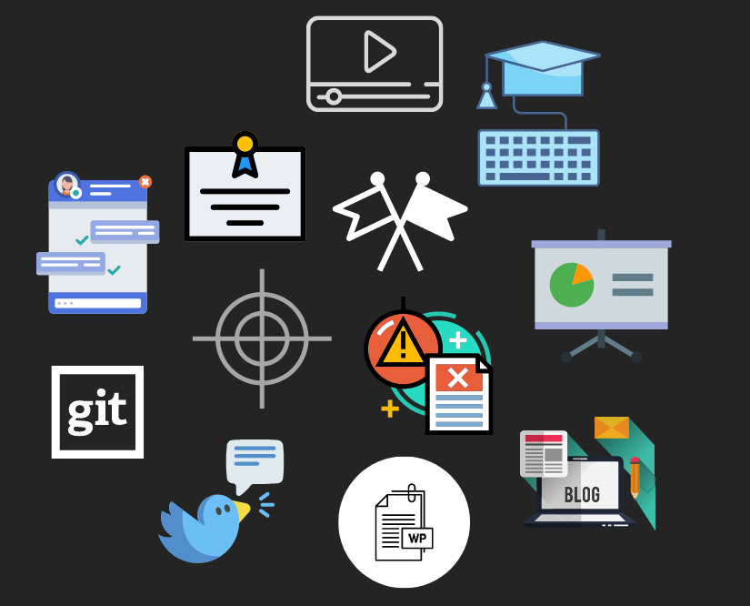
Learning Material Landscape
White papers
Slide presentations
Conference talk recordings
Blog posts
Tweets
Code repositories
Open source tools
Chat servers
Capture-the-flag competitions
Cyber ranges
Threat reports
Certification courses, college courses, and MOOCs
Notes:
Before I put forth an approachable, realistic framework for “self study” that you may be willing to commit to – let’s first talk about the various readily-accessible knowledge sources at our fingertips.
As a person interested in digital forensics, There is a wealth of quality, freely available information sources that go into detail on any specific topic you can think of.
Delivery methods include: white papers, slide presentations, conference talks, blog posts, tweets, code repositories, open source tools, and you get the idea..
That’s one of the really great things about our field – information security practitioners are happy to share their work for free.

Slide 7
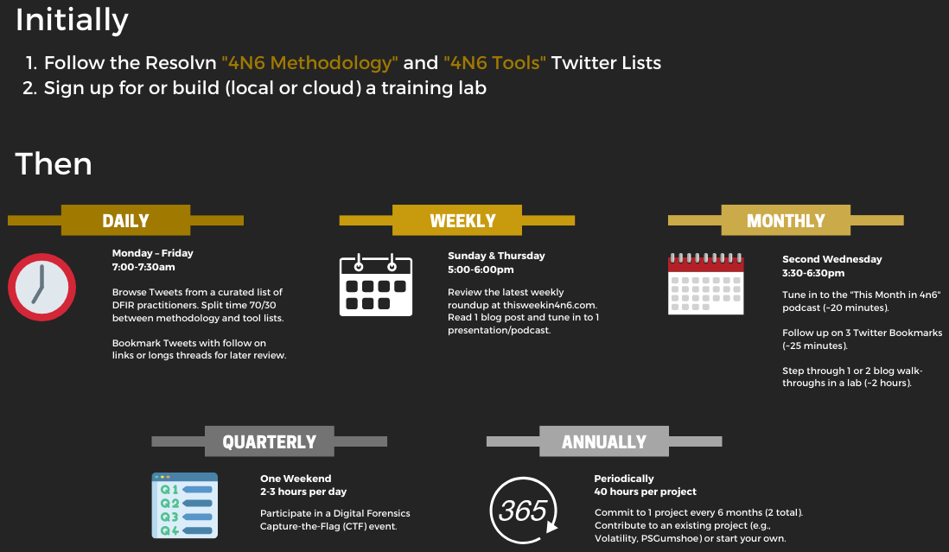
Self-study Framework
Notes:
But with all of the available sources I just mentioned, and new content being released daily – it is EXTREMELY easy to get lost in the overwhelming amount of information – what you may have heard referred to as information paralysis or analysis paralysis. Also, it can be very difficult, and even daunting, to start making progress when you can’t decide what’s worth focusing on, and where to start –
Leading up to this, I’ve broached the subject of being a self-starter, and stepping outside of costly instructor-led training.. now once you decide to lean in and learn more… where should you go!?
At the beginning of this presentation I referred to a Practical Framework. By practical I mean realistic, digestible, and doable without risk of burnout. The goal here is to make progress sustainably, and not throw off your work, sleep, or family schedule. It’s basically the opposite of gym or diet-related New Year’s resolution.
First, there are some one-time costs – the first is to get access to Twitter so you can keep up with the postings of a curated group of 4n6 practitioners. Twitter is one of the best resources for recent technical forensics content. I’ve gone ahead and done the legwork of identifying and grouping those quality Twitter accounts for you so all you need to do is scroll and read! The second to do is to get access to a training lab or cyber range. I’ve added some great starting points in the resources section at the end of this presentation.
Then… you commit to a prescribed schedule. If you’re considering adopting this method, you should absolutely feel free to make changes to the days, times, and knowledge sources as you see fit. I only recommend that you do your best to stick to the high-level actions and cadence – for example, definitely try to participate in CTFs at least four times a year!
My first recommendation is to spend a half hour on Twitter daily, reading and bookmarking technical posts
Then, on a weekly basis dedicate time on two different days to one of my favorite resources – a website called this week in forensics. Maintained by a gentlemen named Phil Moore, this project contains currated, organized digital forensics content for you to dive in to. He puts in a lot of time so you don’t need to.
Then once a month, you can listen to phil and guests’ monthly summary of digital forensics happenings. This is also a good time to revisit a few twitter posts you bookmarked. Ideally, these tweets have followon links and/or long threads with good discussion points.
Next, monthly you should absolutely spend time recreating environments and stepping through walkthroughs detailed in 1 or two of the blog postings you read the previous month. I recommend picking one focused on a new forensics technique and another focused on leveraging a new tool.
Moving on to quarterly, I suggest you set weekend time aside to participate in a CTF four times a year. You can keep track of interesting CTFs using the same website I mentioned earlier – thisweekin4n6.com.
And finally, I recommend you work on two projects a year. Whether it’s writing forensics tool related code, building test networks, or exploring new tradecraft, you are sure to pick up new skills throughout the process. This can be in 30 minute chunks, or weekend long sprints – track your time during these sessions and commit to about a week for each project.

Slide 8
Resources
Media
thisweekin4n6.com
Training Labs / Cyber Ranges
DetectionLab – detectionlab.network
BlueCloud Cyber Range – blue.iknowjason.io
“Building a Lab” YouTube Playlist – by Justin Henderson
Visit github.com/resolvn/whcr for a complete list of resources
CORE VALUES STATEMENT
“As Information Security Practitioners, we CONSISTENTLY DELIVER. We are CONCISE, PRECISE, and ACCURATE and have TOUGH CONVERSATIONS KINDLY. We unceasingly RAGE to MASTER OUR CRAFT, EXPERIMENTING and EMBRACING FAILURE along the way. Through this process, we LEARN QUICKLY and CONTINUOUSLY IMPROVE, fostering a strong BELIEF IN OURSELVES.”
Notes:
Listed here are the training lab resources I alluded to early on. Also, I’ve gone ahead and posted these slides along with quite a bit more for you to check out in a github repo at github.com/resolvn/whcr
As I wrap up this presentation, I’ll close with a modified version of my company’s core values statement. May it be something you can turn to if you’re ever in need of some outside motivation.
“As Information Security Practitioners, we CONSISTENTLY DELIVER. We are CONCISE, PRECISE, and ACCURATE and have TOUGH CONVERSATIONS KINDLY. We unceasingly RAGE to MASTER OUR CRAFT, EXPERIMENTING and EMBRACING FAILURE along the way. Through this process, we LEARN QUICKLY and CONTINUOUSLY IMPROVE, fostering a strong BELIEF IN OURSELVES.”
Thank you all for your attention. I hope you truly enjoy this year’s International White Hat Conference. At this time, I’ll open it up to the audience for a Questions.

Slide 9
Q & A

